Slide 1
Landing in the professional world
Moving from academia into business
PJ Dunn

Slide 2
Preparing to launch
Do your homework

Slide 3
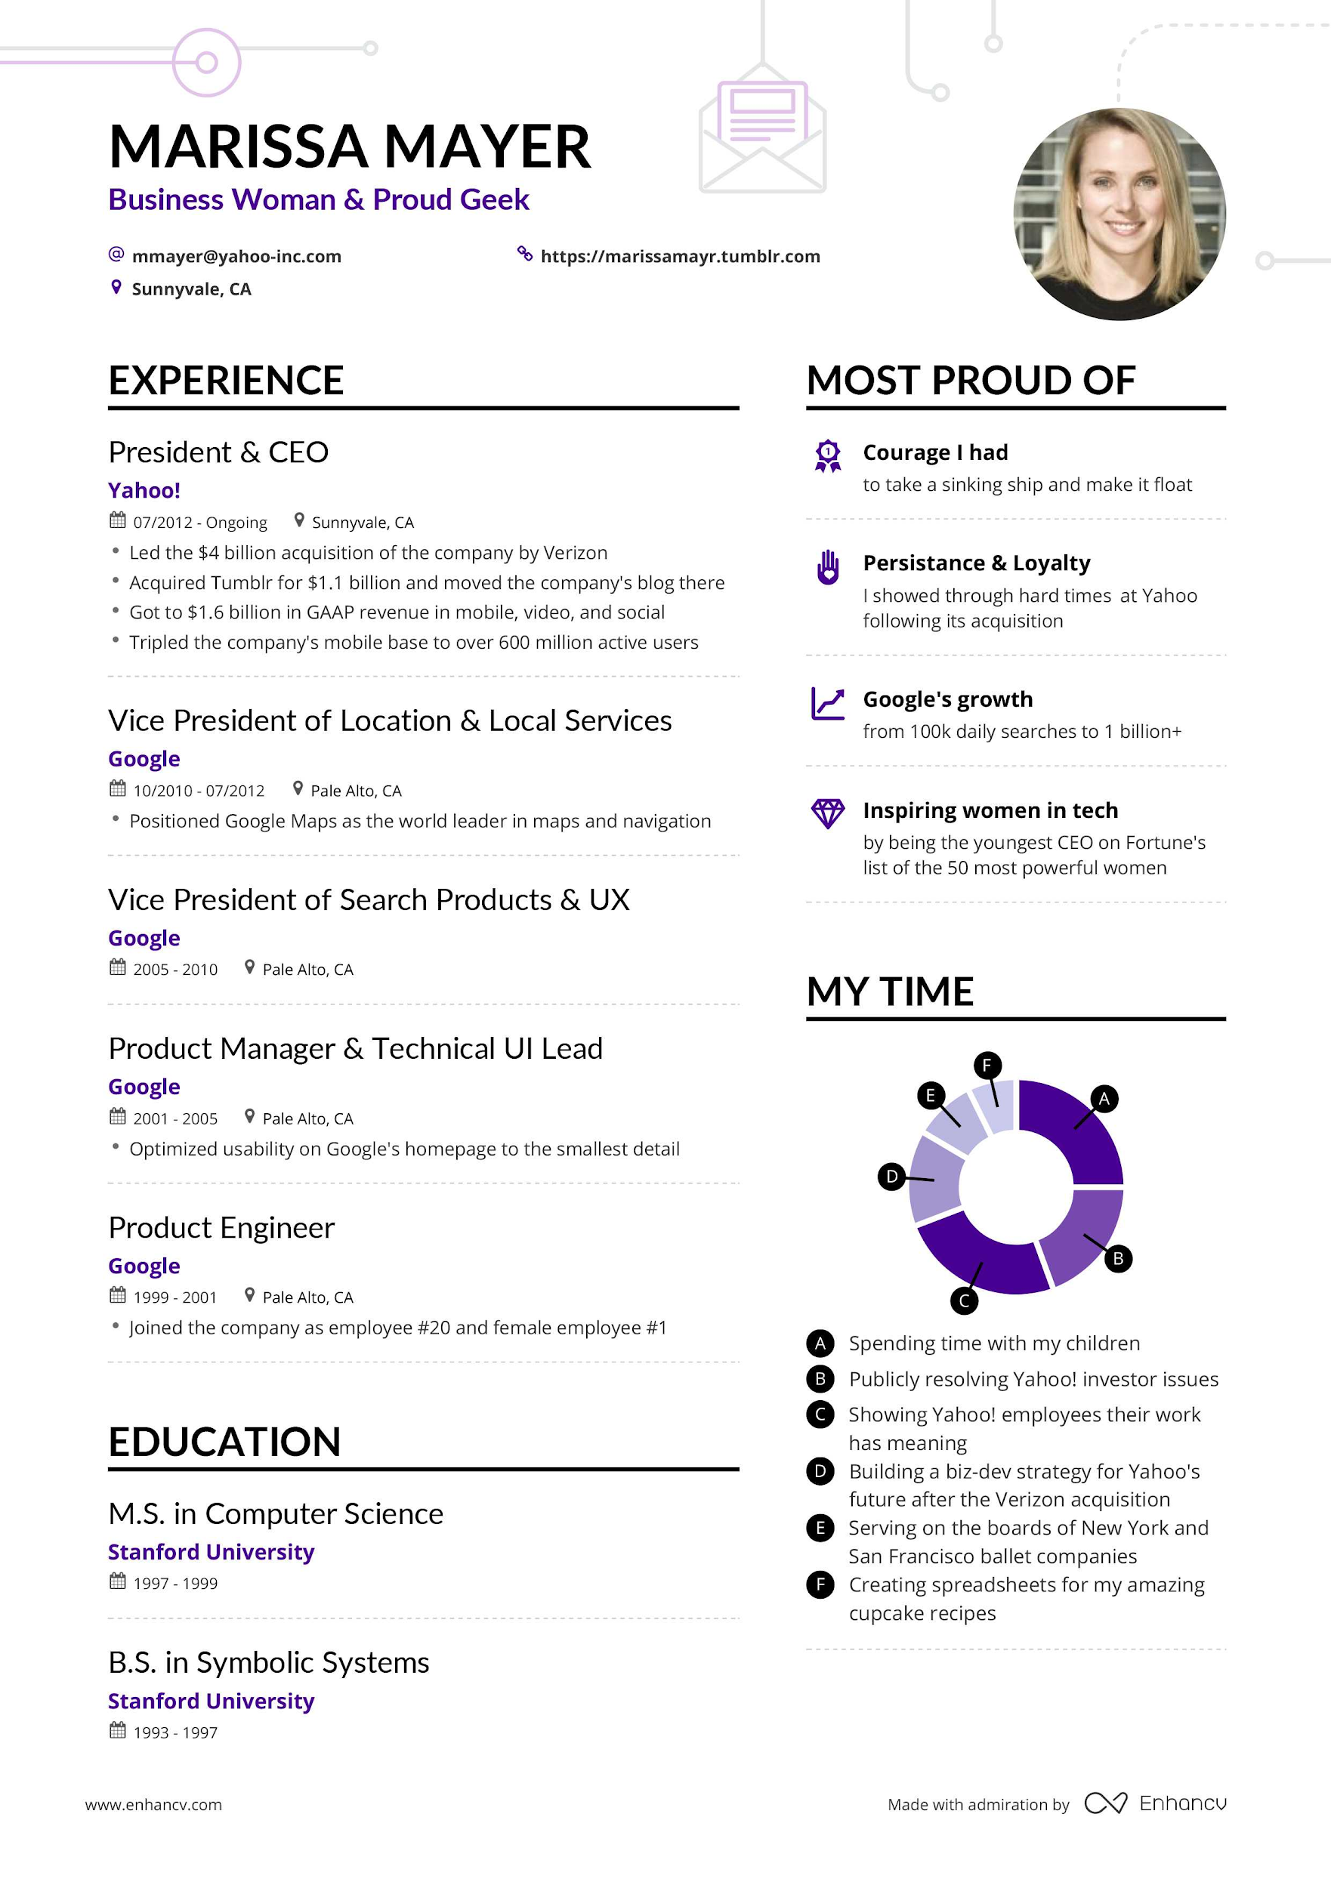
Exceptional resume example
Why does this resume stand out?
(besides her experience)

Slide 4
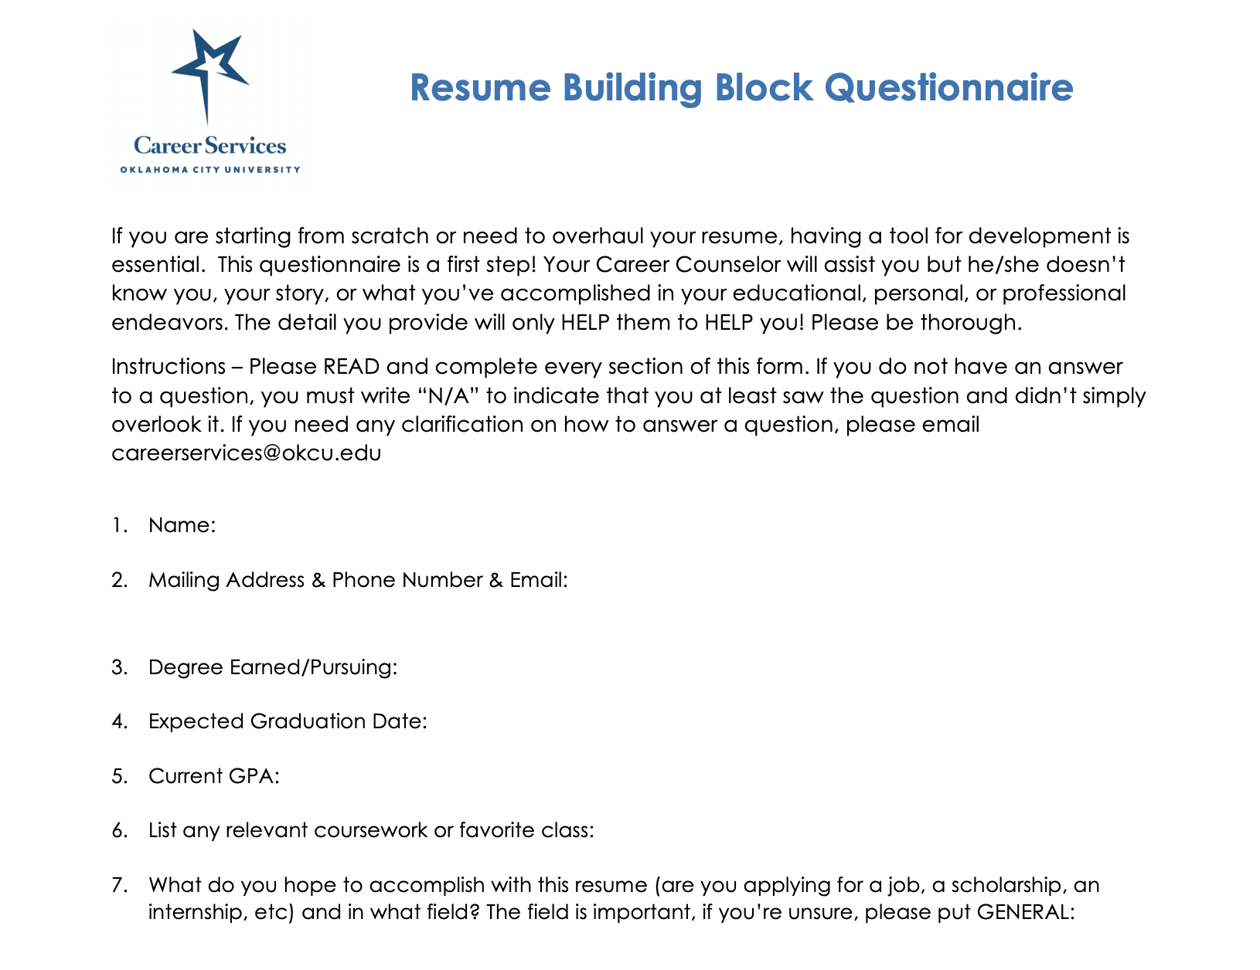
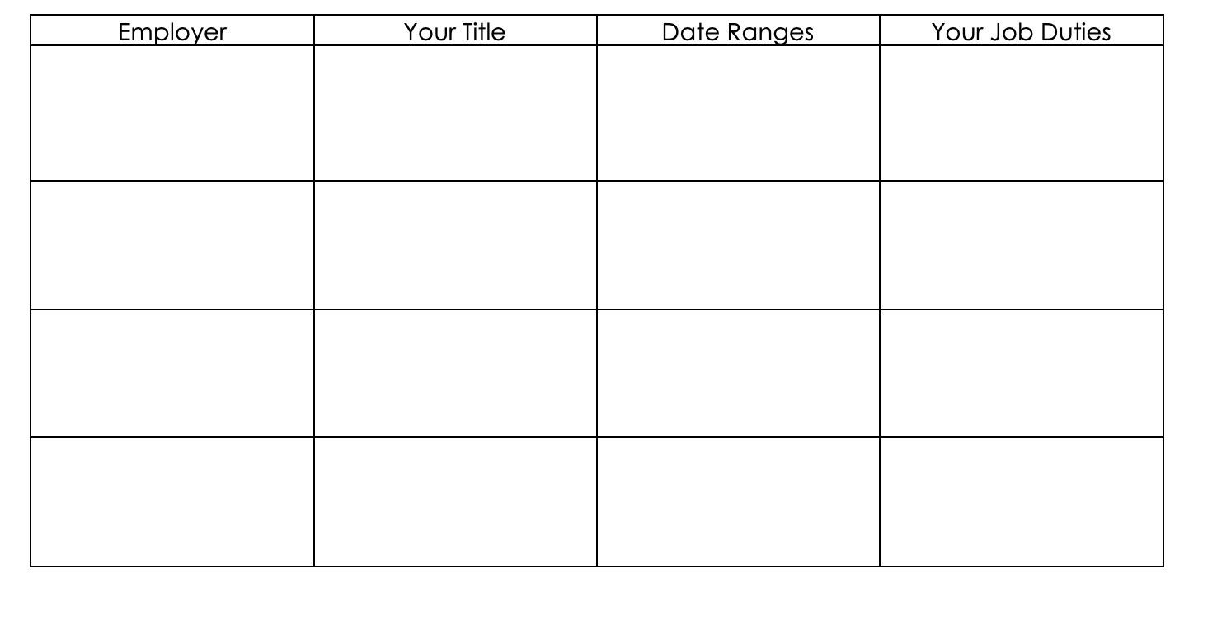
Step 1: Collect the information
Find a good resume questionnaire template
https://www.okcu.edu/uploads/students/career-services/docs/resume-building-block-questionnaire.pdf

Slide 5
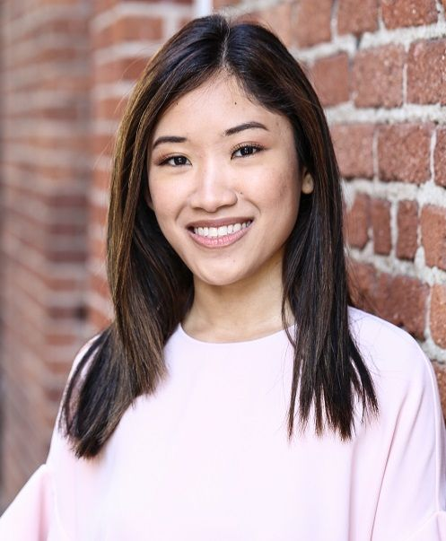
Don’t forget to get a good headshot
Remember to smile
Wear your interview clothes
Have the picture at high resolution and scale down if need be
Be sure to add to LinkedIn, Skype, Gmail or any communication medium
Neutral background
Business attire

Slide 6
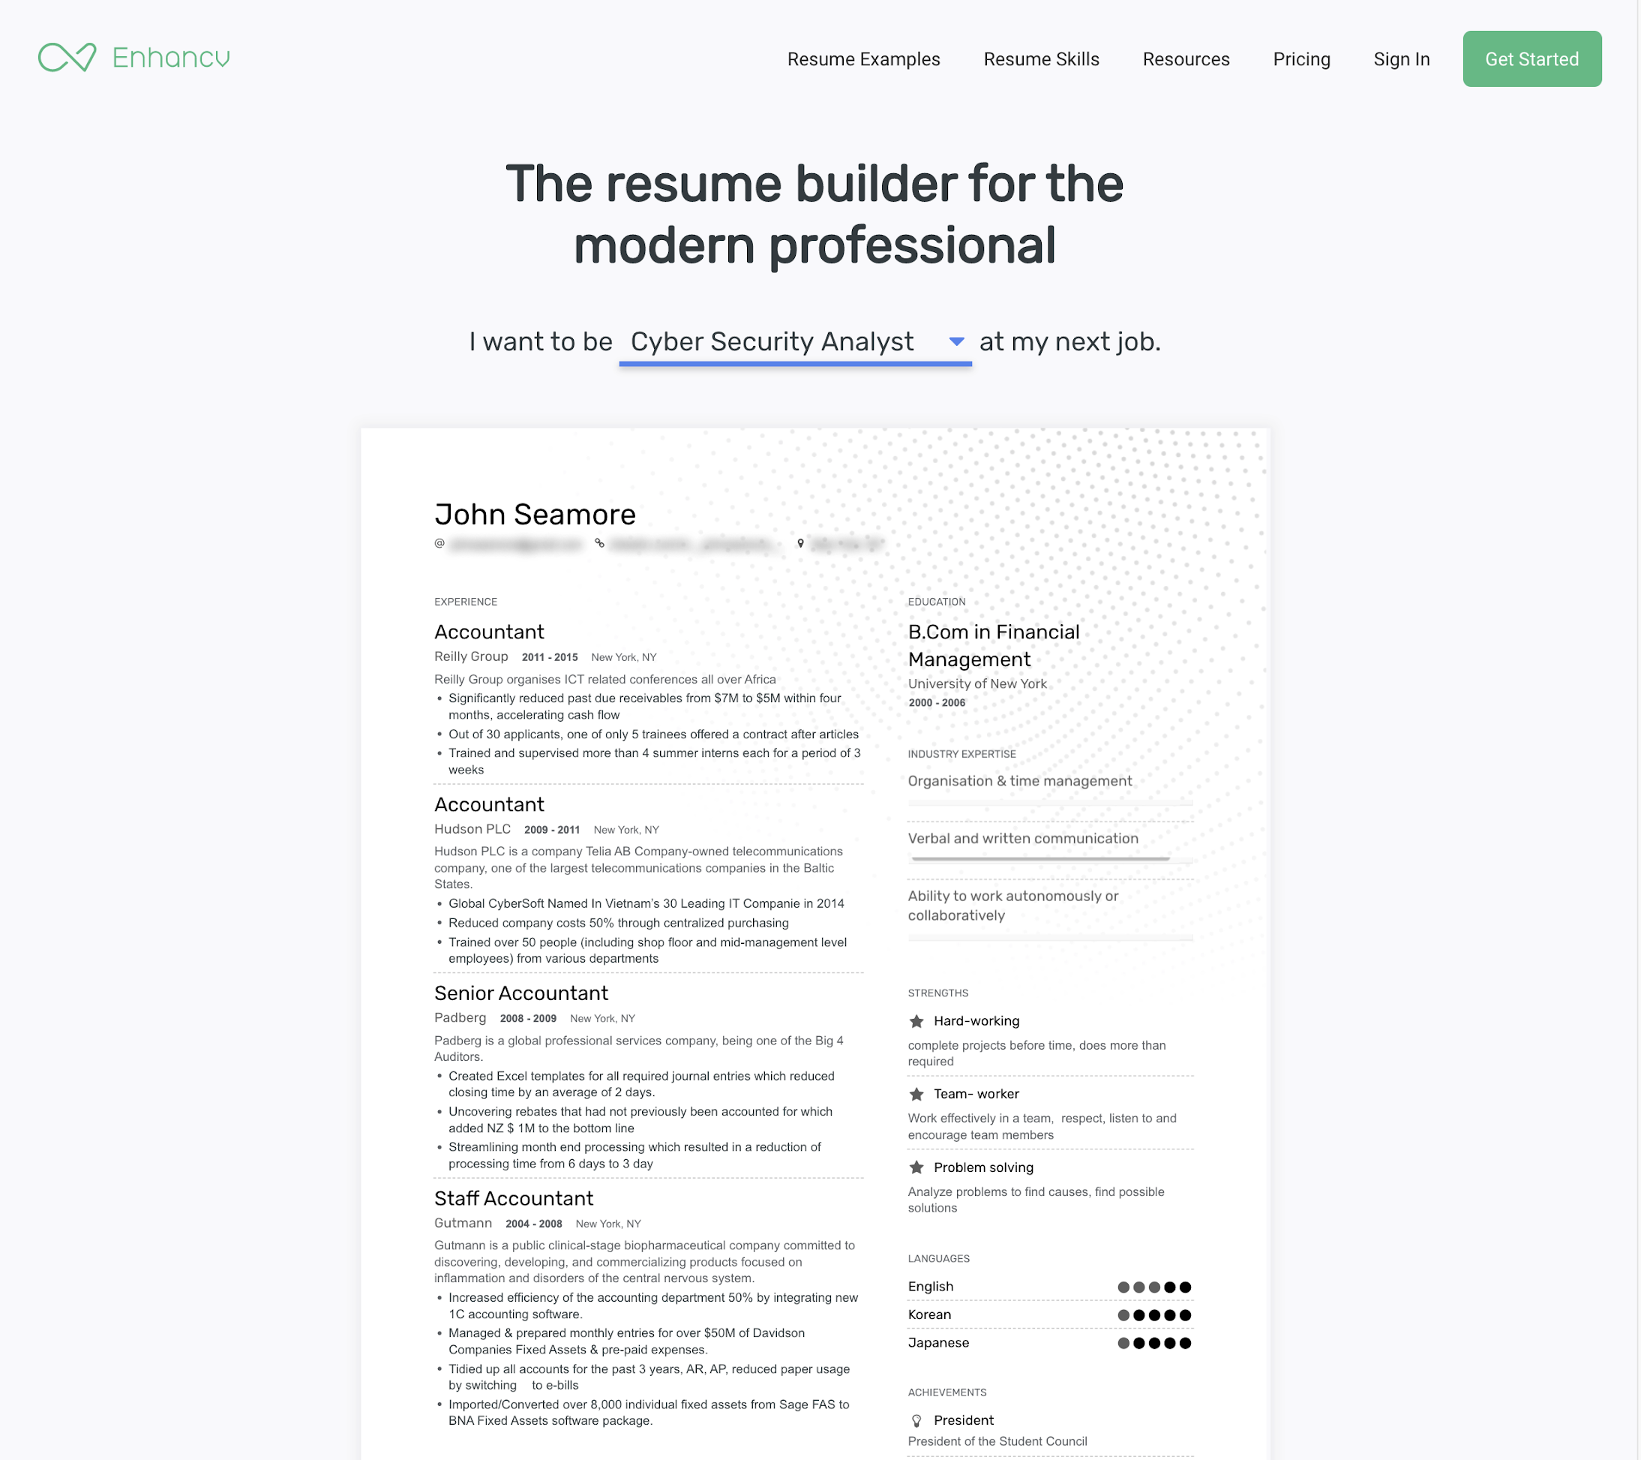
Step 2: Try out a resume builder site to get a good look
Pro tip:
Try out EnhanCV for free and if you like it, either pay for a subscription or build a similar style in PowerPoint
http://enhancv.com
https://resumegenius.com/

Slide 7
Step 3: Never stop updating it
Pro tip:
Get feedback from everyone you can find:
University career services
Alumni
Professionals
Your peers

Slide 8
LinkedIn basics
Key motivations for LinkedIn:
Use it to find people to network with; for example, you want to work at Verizon but you don’t know anyone at Verizon. You find out your professor knows someone at Verizon!
Recruiters at Verizon will find YOU quicker because you are connected to those people.
LinkedIn is THE social network for professionals.
This profile is a living connected resume that your network can access.

Slide 9
LinkedIn steps
Create an account
Use your resume to get started
Remember that headshot
Pro tip: Find anything you are proud of academically/professionally on the web and link it
Connect with professionals
Family
Friends
ISACA members
People who work at places you want to work
Join groups
North Texas ISACA
Cloud professionals
Dallas Off Road Biking Association (yes anything that you can connect to!)
Imagine you are a recruiter whose job is to match a candidate with an opening.
When they open your profile, what will they see within 15 seconds?

Slide 10
Business attire fundamentals
If possible - ask ahead of time what the attire is expected.
Common types:
Formal
Business Casual
Casual → “Smart Casual”
Ensure you are comfortable
Cut out itchy tags
Friends
Cross your arms and sit down when purchasing - if it is tight, try on one size up
Pro tip:
Go to consignment stores to search for affordable, high quality items
https://www.thebalancecareers.com/best-interview-attire-for-every-type-of-interview-2061364

Slide 11
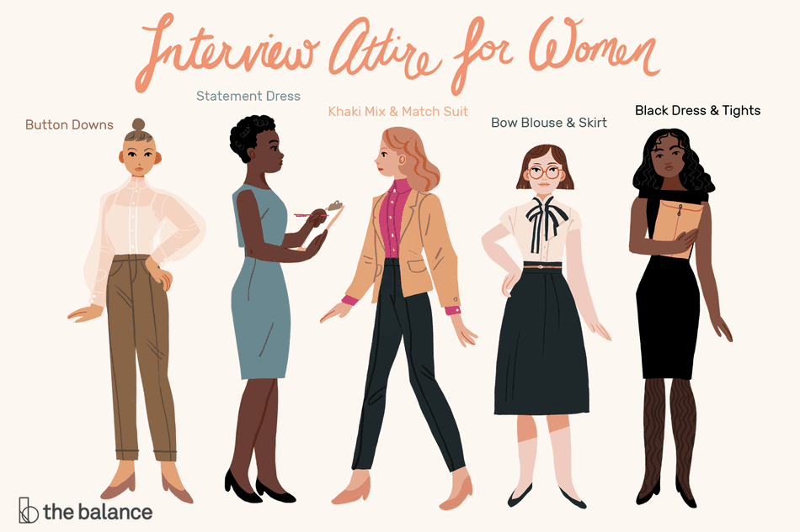
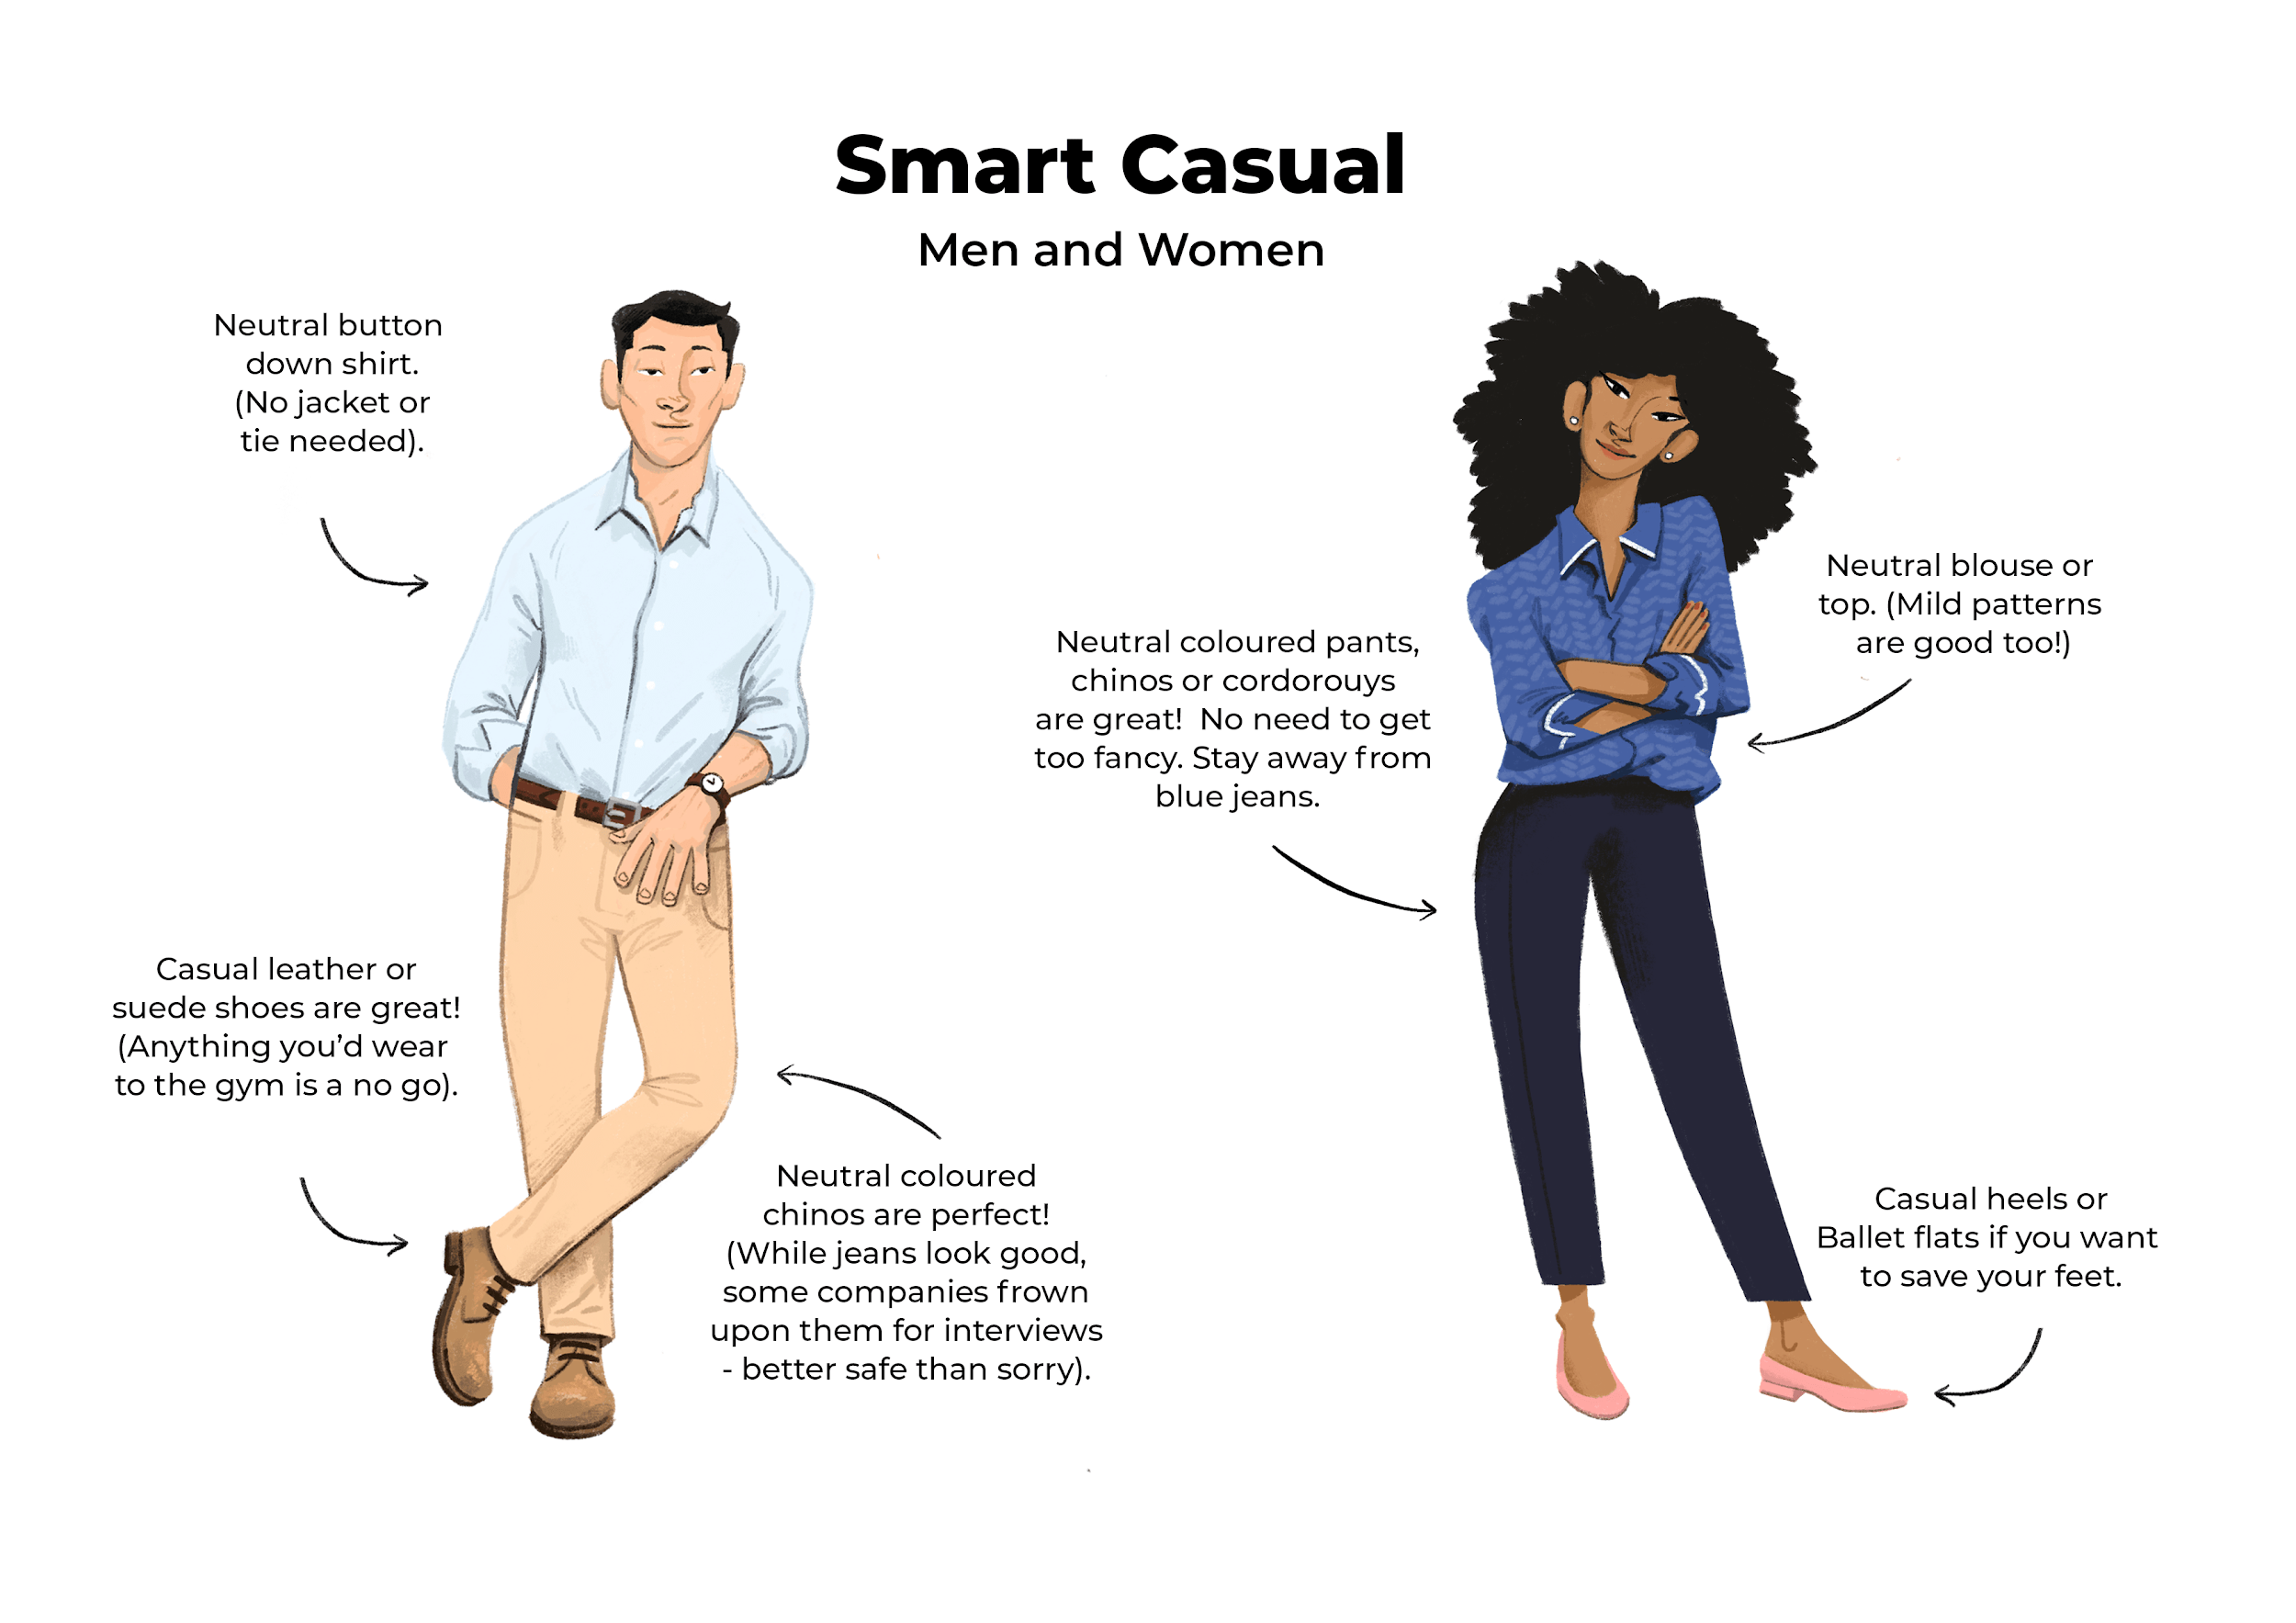
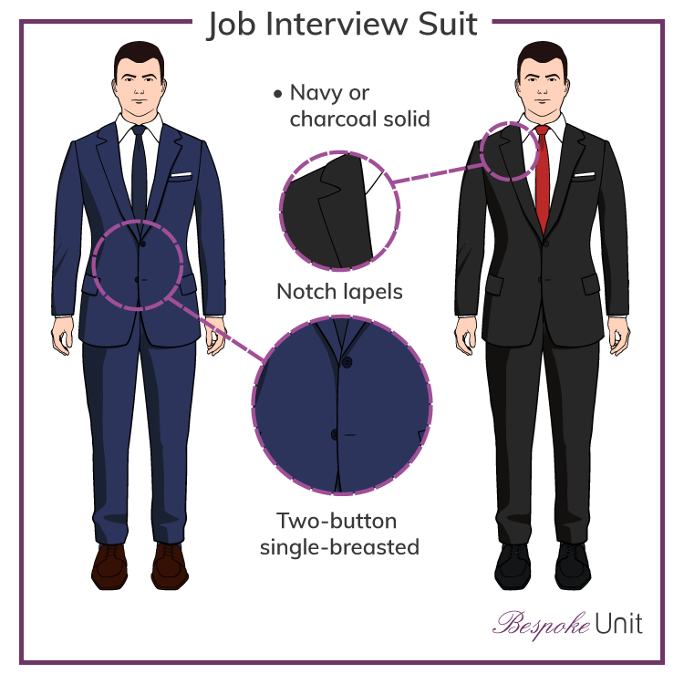
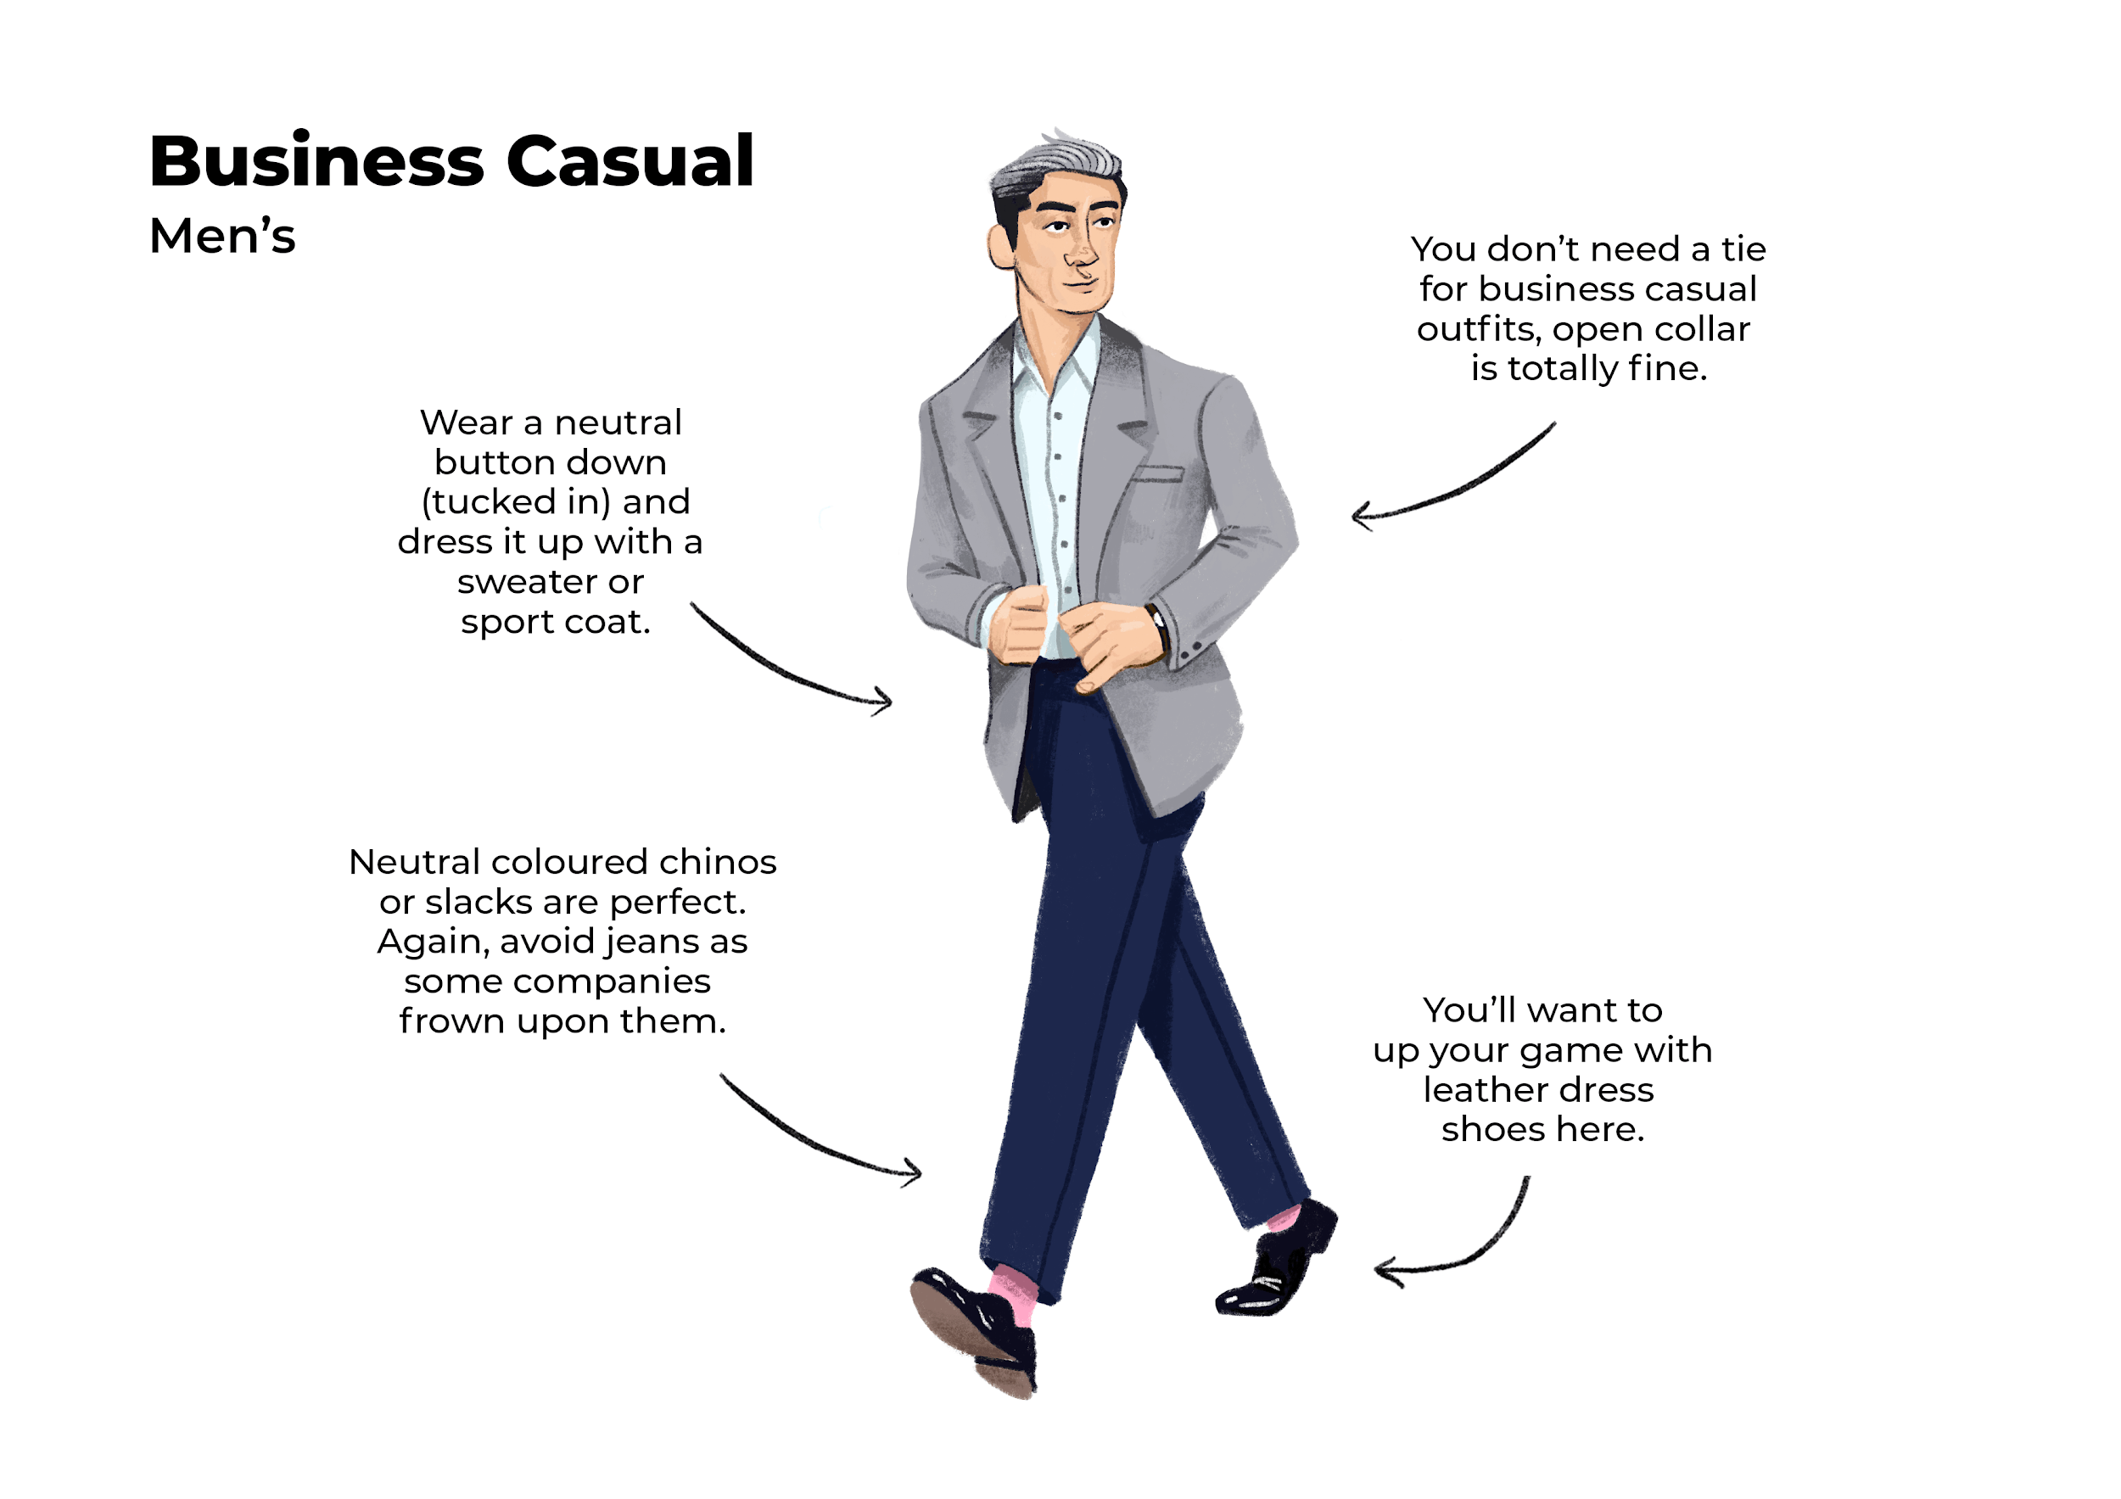
Common professional situations
Formal interviews
“Business Formal”
Job fairs/ networking
“Business Casual”
Informal networking
“Smart Casual”

Slide 12
What is an elevator pitch?
Who are you?
What makes you unique or what skills do you bring?
What are you opportunity are you hoping to land?
“Tell me about yourself”
(you have 30 seconds)
https://cdc.buffalostate.edu/pdf/Pitch_Handout_and_Worksheet_for_Website.pdf

Slide 13
Break time – 10 minutes

Slide 14
Launching
Practice makes perfect

Slide 15
Who paved the way ahead of you?
What roles do they have?
What companies do they work for?
What industry peers would be a good target?
Take 5 minutes to think of 3 people and put a list to answer these questions

Slide 16
Job search sites
Pro tip:
Bookmark the career page of the top 10 companies you want to work for and check weekly for updates
Common job search sites:
University career site
Indeed/LinkedIn
Company career websites, e.g. https://www.verizon.com/about/careers/

Slide 17
Preparing for an interview
Corporate recruiters
Contract recruiters
Research the company & job
Prepare questions they will ask you
Prepare questions you need to ask them
Pro tip:
Find a list of top 20 questions they will ask; write a word document with a narrative style of your responses
https://youtu.be/uPjeKSDuoGw

Slide 18
Day of the interview
Phone interview tips:
Wired headphones with microphone
Call 5 min early or be ready for them to call
Video interview tips:
Test video ahead of time
Position with good posture
Wired headphones with microphone
Ensure web camera angle is optimal
Neutral background with good lighting
Join 15 min ahead of time and test video/audio
In-person interview tips:
Research body language and handshake customs
Watch training videos on making a good first impression
Arrive 30 min early and sit in parking lot
Pro tip:
Have your questions and notes written down in a leather notepad. They like to see you prepared.

Slide 19
Landing
Your perfect career awaits you

Slide 20
Dining etiquette
Sit up straight, no elbows on the table, do not reach across the table
Be cognizant of speaking and interacting while eating
Be kind to your server, you are most likely being judged on your interactions with others
Pro tip:
Don’t order anything that could make a mess (BBQ, spaghetti, etc.)

Slide 21
Interview follow-up
Ask them when to follow up; if you get a vague answer, assume it’s a week.
Follow up in 2 business days with a thank you email -- regardless of your interest
When replying ask if there is anything you can clarify for them
Pro tip:
Be persistent but not annoying. They want to know you are still interested but it may take them a while to finalize the decision.

Slide 22
Accepting or declining an offer
Interviews are a 2-way street--it’s OK if you don’t feel that it is what you are looking for
No matter your interest, take a few days once you get an offer to think about it. Give them that deadline so they know.
Juggling multiple offers/opportunities
Counter offering
Accepting an offer
Declining an offer
Pro tip:
Imagine 5 years from now looking back -- is this the position that gets you where you want to be?
https://youtu.be/uPjeKSDuoGw

Slide 23
What to know your first 90 days on the job
Integrity: Maintain high ethical standards and always acknowledge & credit other
Continual Improvement & feedback:
Organizational Politics
Each organization’s culture and rules of engagement will be different
Observe the Organization Culture:
People: Get to know people in the organization and understand what they do;
Join one or more employee resource groups (if available at your company);
Genuinely express appreciation and acknowledge others; Look for ways that you have to help others
Pro tip:
Relationships and perceptions might matter more than the work you do

